Slide 1

Report and Security Threats to E-Commerce

Slide 2
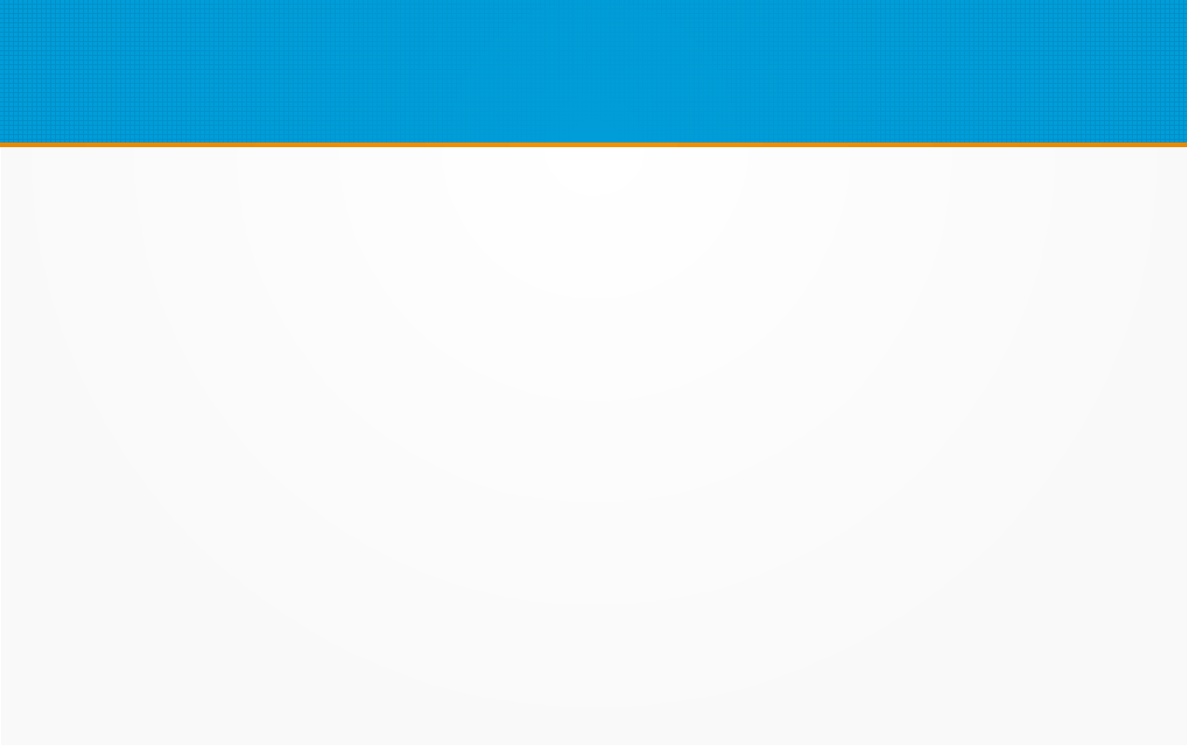
Reports Menu
Magento Community Edition 2.0 provides a wide selection of reports to keep you informed on your marketing efforts, sales products, and customer activity. The Reports menu provides easy access to current information about your sales, products, customers, and promotions.

Slide 3

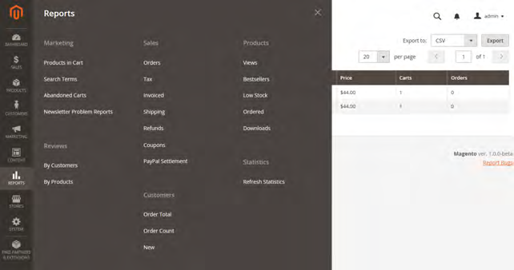

Slide 4
Reports
Marketing Reports
A selection of marketing reports, including Products in Cart, Search Terms, Abandoned Carts, and Newsletter Problem Reports.
Review Reports
The selection of product review reports includes By Customer and By Product.
Sales Reports
The selection of sales reports includes Orders, Tax, Invoiced, Shipping, Refunds, Coupons, and PayPal Settlement.

Slide 5
Reports
Customer Reports
The selection of customer reports includes Order Total, Order Account, and New.
Product Reports
The selection of product reports includes Views, Bestsellers, Low Stock, Ordered, and Downloads.
Statistics
Statistics is a tool that reduces the performance impact of generating reports by calculating and storing statistical data. Rather than recalculate the statistics every time a report is generated, the stored statistics are used until you refresh the statistics.

Slide 6
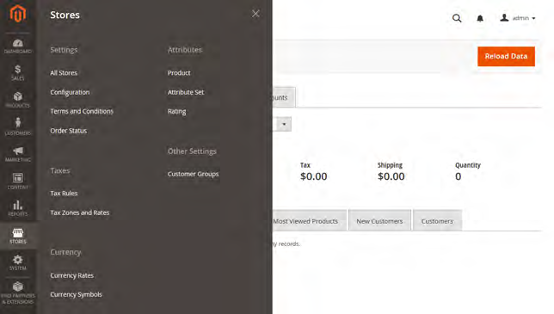
Stores Menu
The Stores menu manages settings that are used less frequently, but referenced throughout your Magento installation, including setting up the store hierarchy, configuration, sales and order settings, tax and currency, product attributes, product review ratings, and customer groups.

Slide 7
The Menu options are:
  All Stores
  Taxes
  Currency
  Attributes
  Customer Groups

Slide 8
All Stores
When Magento Community Edition 2.0 is installed, a main website, and store view are created. You can create additional websites, stores, and store views, as needed.
For example, in addition to your main website, you might have a additional websites with separate domains. Within each website, you can have multiple stores, and within each store, separate store views. Many installations have one website and one store, but with multiple store views to support different languages.

Slide 9
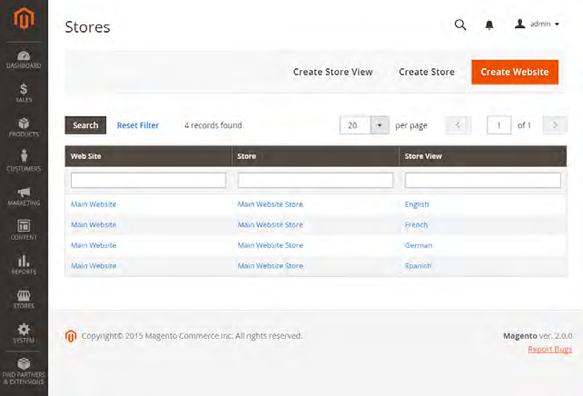
Before you begin, plan your store hierarchy in advance because it is referred to throughout the configuration. Each store can have a separate root category, which makes it possible to have an entirely different set of main menu options for each store.

Slide 10
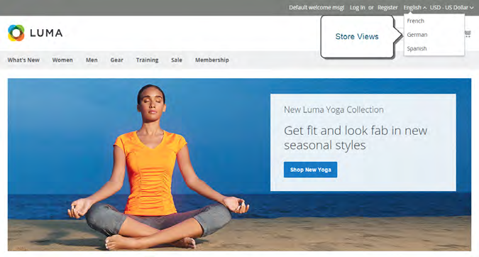
Creating a Store View
Store views are typically used to make the store available in different languages. Shoppers can use the language chooser in the header of the store to change the store view.

Slide 11
To create a new store view:
1. On the Admin sidebar, tap Stores. Then under Settings, choose All Stores.
2. Tap Create Store View . Then, do the following:
a.Set Store to the parent store of this view.
b. Enter a Name for this store view. The name appears in the language chooser in the store header. For example: Spanish.
c. Enter a Code in lowercase characters to identify the view. For example: spanish.
d. To activate the view, set Status to “Enabled.”
e. (Optional) Enter a Sort Order number to determine the sequence in which this view is listed with other views.
When complete, tap Save Store View .

Slide 12
Translating Products
If your store has multiple views in different languages, the same products are available in each store view. You can use the same basic product information, such as SKU, price, and inventory level, regardless of language. Then, translate only the product name, description fields, and meta data as needed for each language.
Translating Field Labels
Translate all categories
Translate Content

Slide 13
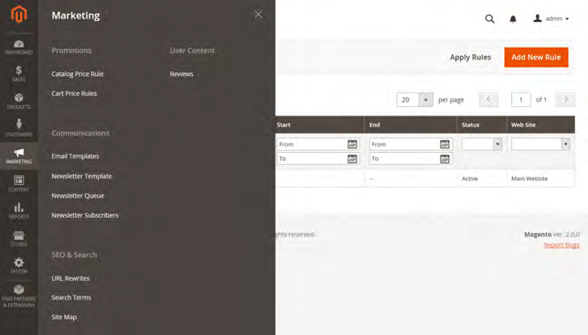
Marketing Automation
Marketing Menu
The Marketing menu provides access tools for managing promotions, communications, SEO, and user-generated content.

Slide 14
Promotions
Create catalog and cart price rules that trigger discounts based on a variety of conditions. Set up promotions that spring into action when the required conditions are met.
Communications
Customize all notifications sent from your store. Create newsletters and publish RSS feeds.
SEO & Search
Analyze search terms to help customers find products in the store, manage meta data, and create a site map. Use redirects to manage URL changes and avoid broken links.

Slide 15
User Content
Leverage user-generated product reviews to create a sense of community, and increase sales.

Slide 16
The Magento content management system
As with most e-commerce platforms, Magento's management of non-product content lacks some of the more robust features of a dedicated content management system (CMS) – such as WordPress, Business Catalyst, or Joomla.
However, to its credit, Magento does provide a versatile system that takes into account the possible need for unique content for each of your stores.

Slide 17
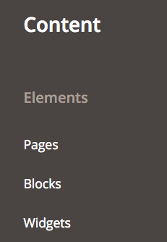
CMS functions of Magento is under the Content menu. This area includes sections for managing Pages, Blocks, and Widgets, as shown in the following screenshot:

Slide 18
Pages
The pages we will use in the CMS are not actually complete pages, as they lack controls for the overall template items of header, navigation, and footer.
These pages actually refer to the central content of a page – that which lies within the overall page template. Within this page, we can add text, images, static blocks, and widgets to give the page its core content.

Slide 19
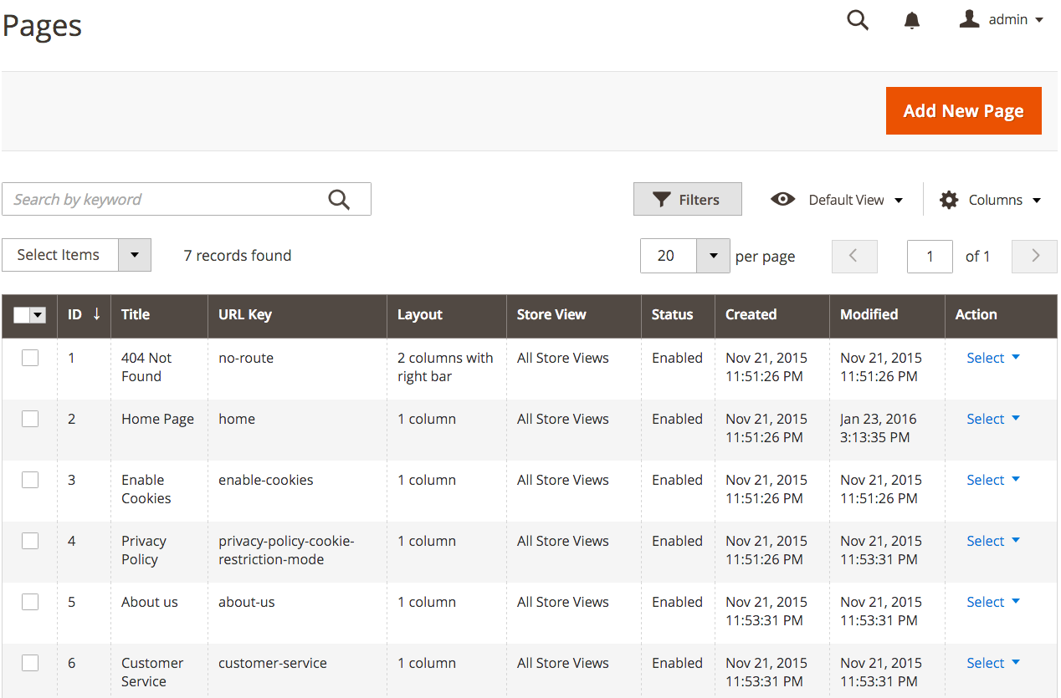

Slide 20
404 Not Found: This page is displayed to visitors who land on a non-existing page in your site. For example, you might have a product that is discontinued and you no longer wish to have it visible to your customers. However, a search engine, blog, or other websites may have a link to that product. If a customer clicks that link and comes to your site, since the item is no longer visible, they would be shown this page.
Home Page: Obviously, this is the home page for your site. The content and design elements that appear in the core of your home page are managed on this page.

Slide 21
Other options are Enable Cookies, Privacy Policy, About Us and Customer Service.
Creating a CMS page
1. Go to Content | Pages in the Magento 2 backend.
2. Click on Add New Page.
The first panel is titled Page Information, as shown in the following screenshot:

Slide 22
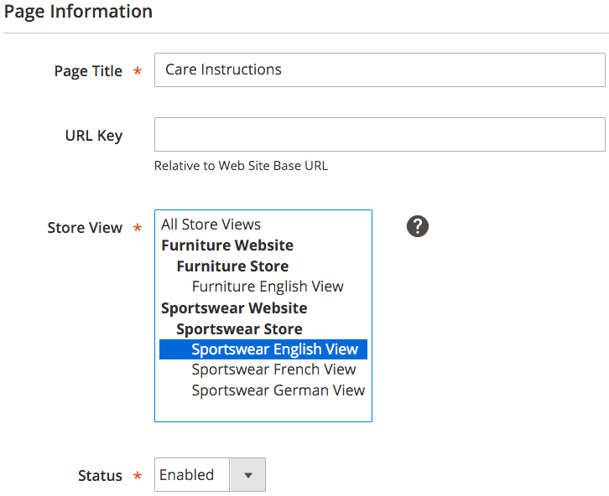

Slide 23
Magento will create the URL Key once the new page is saved. However, you can enter a URL Key here. The URL Key will be the actual name used in the URL to access your page:
For example, http://www.acmesportswear.com/care-instructions.html . If you want another URL Key value, you can enter it here.
The next panel in the new product screen is Content. It is in this panel that you can create the words, images, and so on that will appear in the main content portion of your new page.

Slide 24
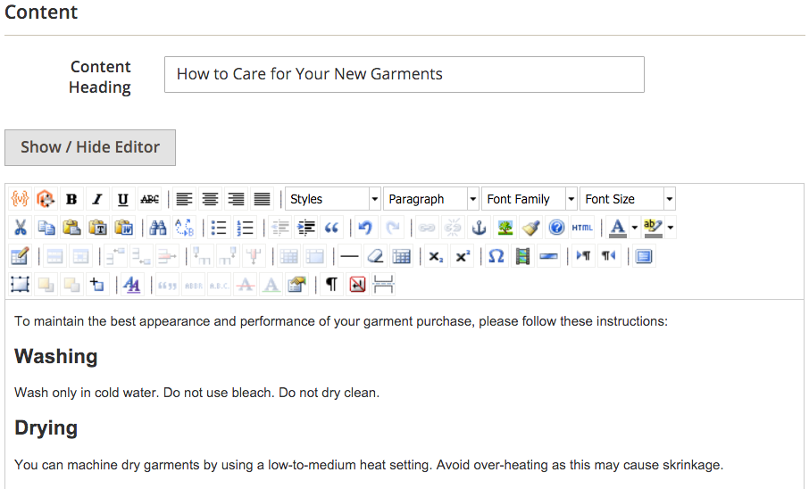

Slide 25
The third panel in the menu on the left side is labeled Design.
Based on your theme, you can change the layout of the page to a one-, two-, or three-column display. You can also specify a special theme design.
There are additional XML statements that can be inserted that will affect your display.
The last panel is Meta Data.

Slide 26
Static Blocks
Static blocks are very useful for displaying the same content in many places.
For instance, you may want to use a static block to regularly display a new product announcement or discount.
By using a static block, you can update this information in one place and have it instantly appear throughout your site wherever it is referenced.

Slide 27
Creating a new store
Before you begin, take some time to plan your store hierarchy because it is referred to throughout the configuration. Each store can have a separate root category, which makes it possible to have a different main menu for each store.

Slide 28
A single installation of Magento can have multiple stores that share the same Admin.
Multiple stores can share the same domain, be set up as subdomains of the same domain, or have entirely different domains.
Stores that have the same IP address and domain, use the same security certificate, and share a single checkout process.
If you want each store to have a dedicated checkout process under its own domain, each store must have a distinct IP address with a separate security certificate.

Slide 29
yourdomain.com/store1
yourdomain.com/store2
Each store has a different path, but shares the same domain.
store1.yourdomain.com
store2.yourdomain.com
Each store has a different subdomain of the primary domain.
store1.com
store2.com
Each store has a dedicated domain.

Slide 30
The important thing to understand is that the stores use the same Magento code, share the same Admin, and catalog.
Process Overview:
Step 1: Choose the Store Domain
Step 2: Create the New Store
Step 3: Create a Default Store View
Step 4: Configure the Store URL

Slide 31
Step 1: Choose the Store Domain
The first step is to choose how you want to position the store. Will the stores share the same domain, each have a subdomain, or have distinctly different domains? For each store, do one of the following:
l To place the store one level below the primary domain, you don’t have to do anything.
l Set up a subdomain of your primary domain.
l Set up a different primary domain

Slide 32
Create the New Store
1. On the Admin sidebar, tap Stores. Then under Settings, choose All Stores.
2. Tap Create Store . Then, do the following:
a. Choose the Web Site that is to be the parent of the new store. If the installation has only one web site, accept the default, “Main Website.”
b. Enter a Name for the new store. The name is for internal reference only.
c. Set Root Category to the root category that defines the category structure for the main menu of the new store. If you have already created a specific root category for the store, select it. Otherwise, select “Default Category.” You can come back later and update the setting.

Slide 33
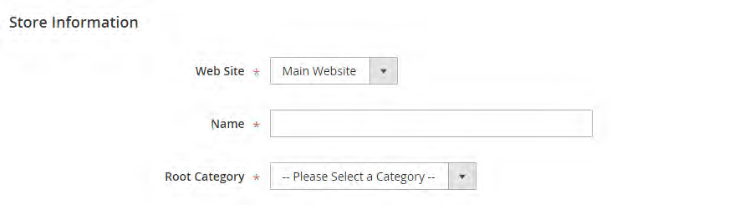
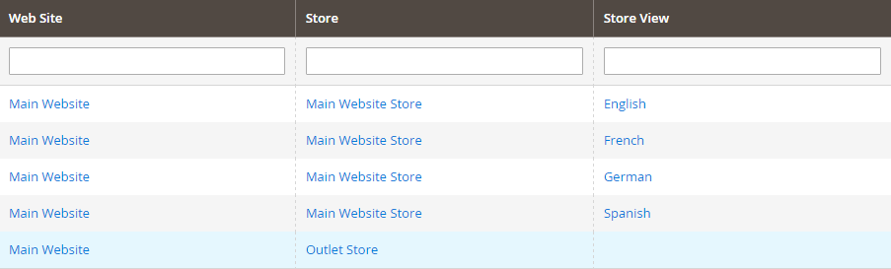
When complete, tap Save Store .

Slide 34
Step 3: Create a Default Store View
1.Tap Create Store View . Then, do the following:
a. Set Store to the new store you created.
b. Enter a Name for the view. For example, "English."
c. Enter a Code for the view in lowercase characters.
d. Set Status to "Enabled."
e. In the Sort Order field, enter a number to determine the store's position when listed with other stores.
2. Tap Save Store View .
If you were to open your store in edit mode, you would see that it now has a default view.

Slide 35
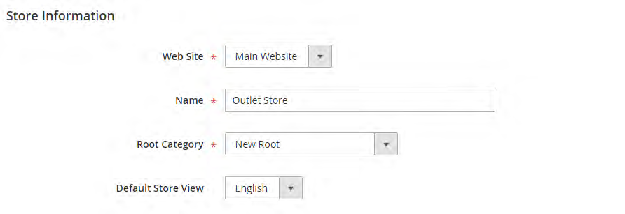
Step 4: Configure the Store URL
1. On the menu bar, tap Stores. Then under Settings, choose Configuration.
2. In the panel on the left under General, choose Web.
3. In the upper-left corner, set Store View to the view that you created for the
new store. When prompted to confirm scope switching, tap OK .

Slide 36
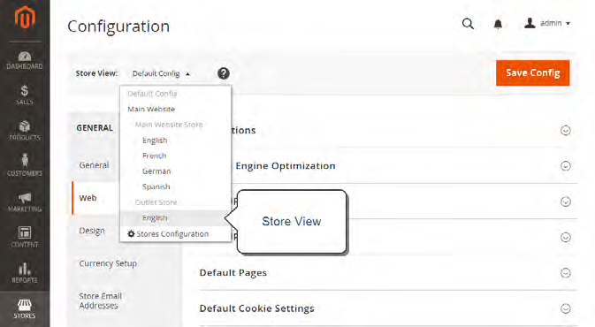
Expand the Base URLs section. Then, do the following:
a. After the Base URL field, clear the Use Website checkbox.
b. Enter the Base URL for the store.

Slide 37
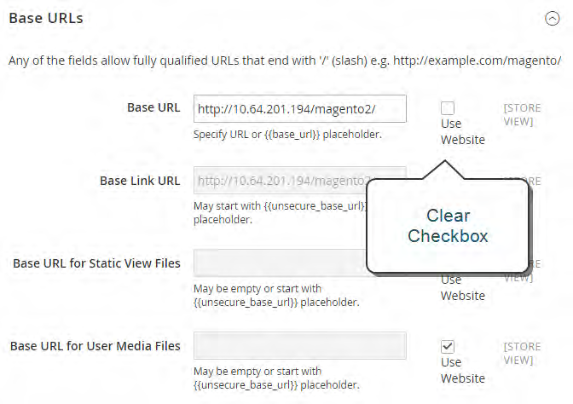
Expand
the Secure Base URLs section, and repeat the previous step as needed to configure the store’s secure URL.
6. When complete, tap Save Config .

Slide 38
Creating a Website
Multiple websites can be set up that use the same Magento installation. The websites can be set up to use the same domain, or different domains.
Step 1: Create a New Website
1. On the Admin sidebar, tap Stores. Then under Settings, choose All Stores.
2. Tap Create Website . Then, do the following:
In the Name field, enter the domain of the new website. For example, “domain.com.”
b. Enter a Code that will be used on the server to point to the domain. The code must begin
with a lower-case letter, and can include any combination of letters (a-z), numbers (0-9),
and the hyphen (-) character.
c. (Optional) Enter a Sort Order number to determine the sequence in which this site is
listed with other sites. Enter a zero to make this site appear at the top of the list.
d. To make this the default website for your Magento installation, mark the Set as Default
checkbox.

Slide 39
3. When complete, tap Save Website .
4. Set up each store and store view that is needed for the new website.

